Slide 1

Efficacy and Safety of the Oral PCSK9 Inhibitor, MK-0616, a Macrocyclic Peptide, in the Treatment of Hypercholesterolemia: A Phase 2b Randomized Placebo-Controlled Clinical Trial
Speaker: Christie M. Ballantyne, MD¹
on behalf of Puja Banka, MD²; Gustavo Mendez, MD³; Raymundo Garcia, MD⁴; Julio Rosenstock, MD⁵; Anthony Rodgers, MS²; Geraldine Mendizabal, MD²; Yale Mitchel, MD²; Alberico L. Catapano, MDhc, PhD^{6,7}
¹Baylor College of Medicine, Houston, Texas, USA; ²Merck & Co., Inc., Rahway, NJ, USA; ³Hospital Angeles Xalapa, Xalapa, Veracruz, México; ⁴Unidad Biomedica Avanzada Monterrey, Monterrey, Nuevo León, Mexico; ⁵Velocity Clinical Research at Medical City, Dallas, TX, USA; ⁶University of Milan; ⁷IRCCS Multimedica, Milan, Italy

Slide 2
Disclaimer
The views and opinions expressed in this educational activity are those of the faculty and do not necessarily represent the views of TotalCME, Inc., the CME providers, or the companies providing educational grants. This presentation is not intended to define an exclusive course of patient management; the participant should use their clinical judgment, knowledge, experience, and diagnostic skills in applying or adopting for professional use any of the information provided herein. Any procedures, medications, or other courses of diagnosis or treatment discussed or suggested in this activity should not be used by clinicians without evaluation of their patient's conditions and possible contraindications or dangers in use, review of any applicable manufacturer’s product information, and comparison with recommendations of other authorities. Links to other sites may be provided as additional sources of information.

Slide 3
Disclosures
Dr. Ballantyne has received grant/research support through his institution from Abbott Diagnostic, Akcea, Amgen, Arrowhead, Esperion, Ionis, Merck & Co., Inc, New Amsterdam, Novartis, Novo Nordisk, Regeneron, and Roche Diagnostic and has been a consultant for 89Bio, Abbott Diagnostics, Alnylam Pharmaceuticals, Althera, Amarin, Amgen, Arrowhead, Astra Zeneca, Denka Seiken, Esperion, Genentech, Gilead, Illumina, Ionis, Matinas BioPharma Inc, Merck & Co., Inc, New Amsterdam, Novartis, Novo Nordisk, Pfizer, Regeneron, and Roche Diagnostic
This trial was funded by Merck Sharp & Dohme LLC, a subsidiary of Merck & Co., Inc., Rahway, NJ, USA

Slide 4
Background
Elevated low density lipoprotein cholesterol (LDL-C) is a primary causative factor for atherosclerotic cardiovascular disease (ASCVD)
Despite effective treatments (e.g., statins), a large proportion of patients fail to achieve guideline-recommended LDL-C levels
Injectable treatments targeting proprotein convertase subtilisin/kexin type 9 (PCSK9) have demonstrated large reductions in LDL-C and decreased risk of ASCVD events, but access barriers and need for repeat injections have led to poor adoption
An oral PCSK9 inhibitor may widen access and improve attainment of guideline-recommended treatment goals

Slide 5
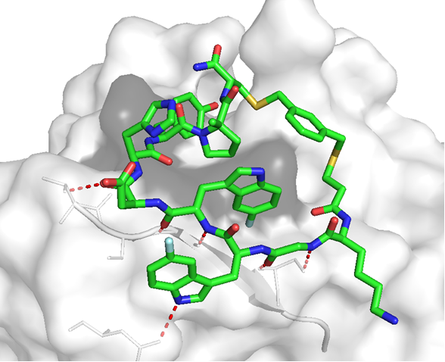
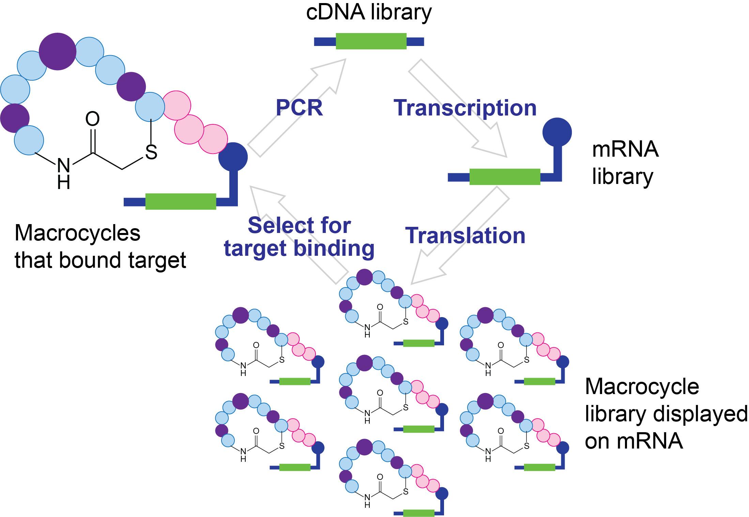
Development of MK-0616: An Oral PCSK9i
Large diffuse/flat surface of PCSK9/LDL-receptor interaction difficult to disrupt with typical small molecules
Macrocyclic peptides can bind PCSK9 with monoclonal antibody-like affinity at 1/100th molecular weight
Macrocycle Library
Macrocyclic peptides displayed on mRNA
Macrocyclic Peptide
Predecessor to MK-0616
Hit-finding platform
mRNA display
Medicinal Chemistry
Structure-Based Drug Discovery
Screening of ultra-large libraries (10¹⁴ potential compounds)
Improve structure-activity relationship, PK and stability
MW = ~1500 g/mol
Ki = 2-5 pM
Tucker TJ, et al. J Med Chem. 2021;64(22):16770-16800.

Slide 6
Study Design: Phase 2b, Multicenter, Randomized, Controlled Trial of MK-0616
6 mg once daily
Follow Up
12 mg once daily
Follow Up
Randomization
1:1:1:1:1
Ratio
Screening
18 mg once daily
Follow Up
N=381
30 mg once daily
Follow Up
Placebo
Follow Up
Day 1
Wk 2
Wk 4
Wk 8
Wk 10
Wk 16
Up to 3-week
Screening Period
8-week Treatment Period
8-week Follow-Up Period
End of treatment
Baseline
Stable lipid-lowering therapy or
no lipid-lowering therapy throughout the trial

Slide 7
Results – Baseline Participant Characteristics
 | MK-0616 |  |  |  | Placebo | Total
 | 6 mg (n=77) | 12 mg (n=76) | 18 mg (n=76) | 30 mg (n=76) | (n=76) | (n=381)
Sex (female), n (%) | 38 (49.4) | 35 (46.1) | 39 (51.3) | 38 (50.0) | 38 (50.0) | 188 (49.3)
Age, mean ± SD, years | 61.7 ±10.3 | 62.0 ± 9.4 | 62.0 ± 9.2 | 60.9 ± 10.2 | 60.6 ± 9.3 | 61.5 ± 9.7
Type 2 Diabetes, n (%) | 39 (50.6) | 45 (59.2) | 45 (59.2) | 37 (48.7) | 45 (59.2) | 211 (55.4)
Race, n (%)
White | 49 (63.6) | 48 (63.2) | 55 (72.4) | 44 (57.9) | 54 (71.1) | 250 (65.6)
Asian | 18 (23.4) | 13 (17.1) | 11 (14.5) | 13 (17.1) | 8 (10.5) | 63 (16.5)
Black/African American | 4 (5.2) | 5 (6.6) | 2 (2.6) | 9 (11.8) | 4 (5.3) | 24 (6.3)
Multiple | 2 (2.6) | 5 (6.6) | 3 (3.9) | 8 (10.5) | 5 (6.6) | 23 (6.0)
Am. Indian/Alaska Native | 4 (5.2) | 5 (6.6) | 5 (6.6) | 2 (2.6) | 5 (6.6) | 21 (5.5)
Ethnicity, n (%)
Hispanic or Latino | 26 (33.8) | 29 (38.2) | 31 (40.8) | 31 (40.8) | 37 (48.7) | 154 (40.4)
ASCVD risk category, n (%)
Clinical ASCVD | 30 (39.0) | 37 (48.7) | 25 (32.9) | 30 (39.5) | 25 (32.9) | 147 (38.6)
Intermediate/high ASCVD risk | 43 (55.8) | 36 (47.4) | 47 (61.8) | 42 (55.3) | 47 (61.8) | 215 (56.4)
Borderline ASCVD risk | 4 (5.2) | 3 (3.9) | 4 (5.3) | 4 (5.3) | 3 (3.9) | 18 (4.7)
Missing | 0 | 0 | 0 | 0 | 1 (1.3) | 1 (0.3)
LDL-C, mean ± SD, mg/dL | 116.5 ± 37.0 | 117.3 ± 36.4 | 123.7 ± 35.1 | 119.4 ± 36.7 | 120.7 ± 28.3 | 119.5 ± 34.8

Slide 8
Results – Primary Endpoint
LDL-C at Week 8
0
LDL-C reduction from Baseline to Week 8 superior to placebo (p<0.001) for all doses of MK-0616
Near-complete efficacy achieved by 2 weeks with persistent effect over the 8-week treatment period
Results generally consistent across prespecified subgroups
-20
Difference in Percent Change from
Baseline vs. Placebo (95% CI)
-40
-41.2
-60
(-47.8, -34.7)
-55.7
-59.1
(-62.3, -49.1)
-60.9
(-65.7, -52.5)
(-67.6, -54.3)
-80
6 mg
12 mg
18 mg
30 mg
Efficacy Population: All participants who received ≥1 dose, had ≥1 observation for the analysis endpoint, and had baseline data for those analyses that require baseline data.

Slide 9
Results – Secondary Endpoints
ApoB at Week 8 | Non-HDL-C at Week 8 | Achievement of Protocol-Defined Goals†
0
0
100%
9.2%
9.2%
19.5%
14.5%
80%
-20
-20
90.7%
60%
85.5%
90.8%
90.8%
% Participants
80.5%
Difference in Percent Change from
Baseline vs Placebo (95% CI)
Difference in Percent Change from
Baseline vs Placebo (95% CI)
40%
-40
-32.8
-40
(-38.6, -26.9)
-35.9
20%
-45.8
(-42.4, -29.4)
9.3%
-60
(-51.7, -39.9)
-48.7
-51.8
-60
-50.5
0%
(-54.6, -42.8)
(-57.0, -44.0)
-53.2
Placebo
6 mg
12 mg
18 mg
30 mg
(-57.7, -45.9)
(-59.7, -46.7)
-55.8
(-62.3, -49.3)
MK-0616
-80
-80
Achieved goal
Did not achieve goal
6 mg
12 mg
18 mg
30 mg
6 mg
12 mg
18 mg
30 mg
†Defined as:
LDL-C <70 mg/dL (<1.81 mmol/L) in participants with clinical ASCVD;
LDL-C <100 mg/dL (<2.59 mmol/L) in participants with high/intermediate ASCVD risk
LDL-C <130 mg/dL (<3.37 mmol/L) in participants with borderline ASCVD risk
Efficacy Population: All participants who received ≥1 dose, had ≥1 observation for the analysis endpoint, and had baseline data for those analyses that require baseline data.

Slide 10
Results – Safety and Tolerability Over 16 Weeks
 | MK-0616 |  |  |  | Placebo
 | 6 mg (n=77) | 12 mg (n=76) | 18 mg (n=76) | 30 mg (n=76) | (n=75)
n (%) of participants with:
≥1 AE | 34 (44.2) | 30 (39.5) | 33 (43.4) | 32 (42.1) | 33 (44.0)
Discontinued Intervention due to an AE | 2 (2.6) | 0 (0.0) | 2 (2.6) | 2 (2.6) | 1 (1.3)
Serious AEs | 1 (1.3) | 3 (3.9) | 2 (2.6) | 2 (2.6) | 0 (0.0)
Moderate or severe AEs | 10 (13.0) | 9 (11.8) | 10 (13.2) | 12 (15.8) | 11 (14.7)
Study intervention-related AEs* | 6 (7.8) | 11 (14.5) | 11 (14.5) | 8 (10.5) | 8 (10.7)
Deaths** | 0 (0.0) | 0 (0.0) | 1 (1.3) | 0 (0.0) | 0 (0.0)
AE = Adverse Event
* Deemed by the investigator to be possibly, probably, or definitely related to study intervention
** There was one death that was the result of a traffic accident
Safety Populations: All randomized participants who received ≥1 dose

Slide 11
Conclusions
In this Phase 2b randomized controlled trial in a diverse population of hypercholesterolemia patients:
All doses of MK-0616 demonstrated statistically superior reductions in LDL-C vs. placebo with up to 60.9% placebo-adjusted reduction from baseline to Week 8; results were consistent across subgroups
Improvements in ApoB and non-HDL-C were consistent with those observed for LDL-C with up to a 51.8% reduction in ApoB and up to 55.8% reduction in non-HDL-C
MK-0616 was well tolerated with no overall trends in AEs across treatment groups
These data support further development of MK-0616, an oral PCSK9 inhibitor that may improve access to effective LDL-C-lowering therapies and improve attainment of guideline-recommended LDL goals aimed at reducing cardiovascular risk

