Slide 1
WHO? Characterizing Vericiguat Use in a Real-World HFrEF Patient Population
Marat Fudim, MD
Assistant Professor of Medicine
Duke Clinical Research Institute
Durham, NC
Alejandro Victores, Lori D. Bash, Boshu Ru, Ciaran McMullan, Matt Melaragno, Andra Stevenson, Robert John Mentz, James L. Januzzi, JR, Merck & Co., Inc., Rahway, NJ, USA, Massachusetts General Hospital/Harvard Medical School, Boston, MA, USA

Slide 2
Disclaimer
The views and opinions expressed in this educational activity are those of the faculty and do not necessarily represent the views of TotalCME, Inc., the CME providers, or the companies providing educational grants. This presentation is not intended to define an exclusive course of patient management; the participant should use their clinical judgment, knowledge, experience, and diagnostic skills in applying or adopting for professional use any of the information provided herein. Any procedures, medications, or other courses of diagnosis or treatment discussed or suggested in this activity should not be used by clinicians without evaluation of their patient's conditions and possible contraindications or dangers in use, review of any applicable manufacturer’s product information, and comparison with recommendations of other authorities. Links to other sites may be provided as additional sources of information.

Slide 3
Background
Worsening heart failure events (WHFE) affect up to one-third of patients with HFrEF
Vericiguat, the first agent indicated specifically for WHF, is a novel soluble guanylate cyclase (sGC) stimulator approved in 2021 to reduce
risk of cardiovascular death, and
HF hospitalization

Slide 4
Methods
Identified adults in TriNetX Open Claims Database who had filled a prescription for vericiguat between January 1, 2021, and July 4, 2022
Computed summary statistics describing patient and treatment patterns, including those of other GDMT

Slide 5
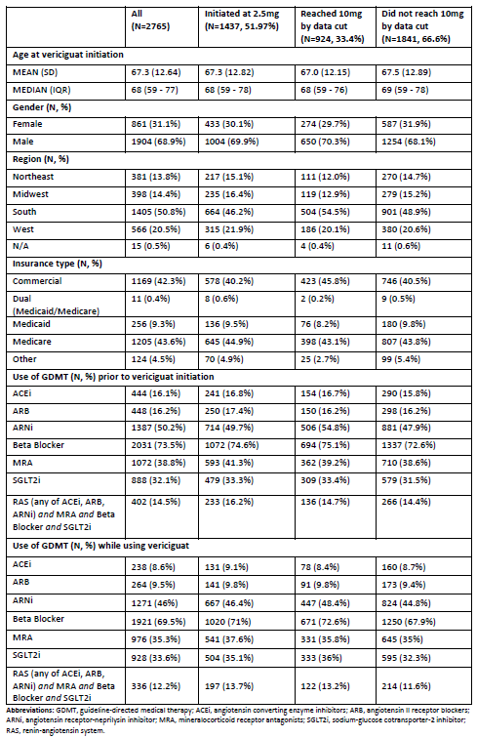
Results
2765 adults treated with vericiguat
Mean age: 67 years
Men (69%)
Insured commercially (42%) or by Medicare (44%)
52% started vericiguat at 2.5 mg
67% did not reach the 10 mg target dose by the end of the study period
Patients initiated vericiguat a median (IQR) of 369 (253, 457) days after US launch
Common concomitant GDMT included beta blockers (70%), ARNi (46%), MRA (35%), and SGLT2i (34%)
Frequency of use of other GDMT medications was similar before and after starting vericiguat, except for ACEi and ARB, which decreased
Those who reached vericiguat target dose (compared to those who did not) tended to more often be on other GDMT

Slide 6
Conclusion
Only one-third of patients reached target dose of vericiguat by the end of the study period
Additional research is needed to better understand characteristics of patients with WHF, including concomitant treatment patterns and real-world effectiveness of vericiguat, in light of current guidelines

