Slide 1






Saturday, October 14, 2023
9:00am – 2:45pm CT
InterContinental Chicago Magnificent Mile Hotel | Chicago, IL
This activity is supported by independent educational grants from Actelion Pharmaceuticals US, Division of Janssen Pharmaceuticals and United Therapeutics Corporation.
Jointly provided by the Global Learning Collaborative (GLC) and Total CME, LLC.

Slide 2



Resource Information
About This Resource
These slides are one component of a continuing education program available online at MedEd On The Go titled Midwest Regional PH Summit – Management of Pulmonary Hypertension with Comorbidities
Program Learning Objectives:
Explain the ERS/ERC guideline updates
Evaluate available evidence-based data and patient management strategies for PH
Identify opportunities to apply effective management strategies to improve patient outcomes
MedEd On The Go®
www.mededonthego.com
This content or portions thereof may not be published, posted online or used in presentations without permission.
This content can be saved for personal use (non-commercial use only) with credit given to the resource authors.
To contact us regarding inaccuracies, omissions or permissions please email us at support@MedEdOTG.com

Slide 3
Disclaimer
The views and opinions expressed in this educational activity are those of the faculty and do not necessarily represent the views of Total CME, LLC, the CME providers, or the companies providing educational grants. This presentation is not intended to define an exclusive course of patient management; the participant should use their clinical judgment, knowledge, experience, and diagnostic skills in applying or adopting for professional use any of the information provided herein. Any procedures, medications, or other courses of diagnosis or treatment discussed or suggested in this activity should not be used by clinicians without evaluation of their patient's conditions and possible contraindications or dangers in use, review of any applicable manufacturer’s product information, and comparison with recommendations of other authorities. Links to other sites may be provided as additional sources of information.

Slide 4
Overview of Major Changes to ERS/ESC Guidelines for PH
Michael J. Cuttica, MD, MS
Associate Professor of Medicine
Director, Northwestern Pulmonary Vascular Disease Program
Northwestern Medicine
Chicago, IL

Slide 5
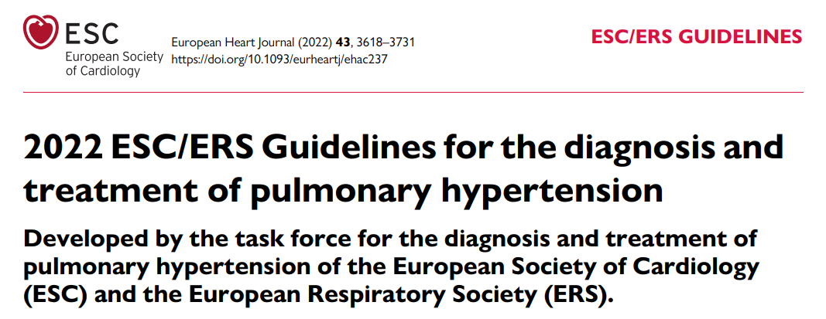
Learning Objectives / Outline
Review background of pulmonary hypertension (PH) and pulmonary arterial hypertension (PAH)
Highlight major updates in the ESC/ERS 2022 Guidelines

Slide 6
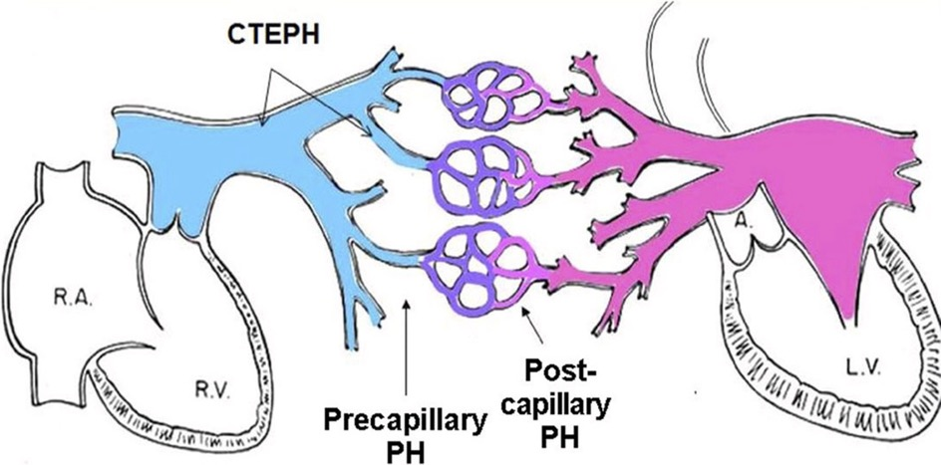
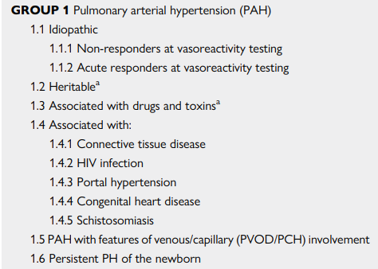
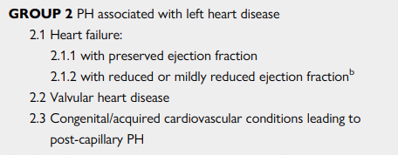
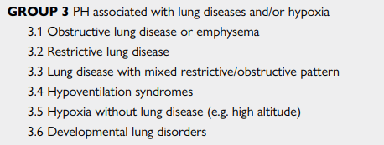
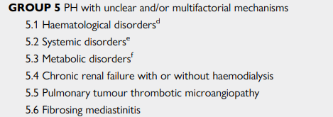

Pulmonary Hypertension
Pulmonary hypertension (PH)
  high pressures in the pulmonary circulation

Slide 7
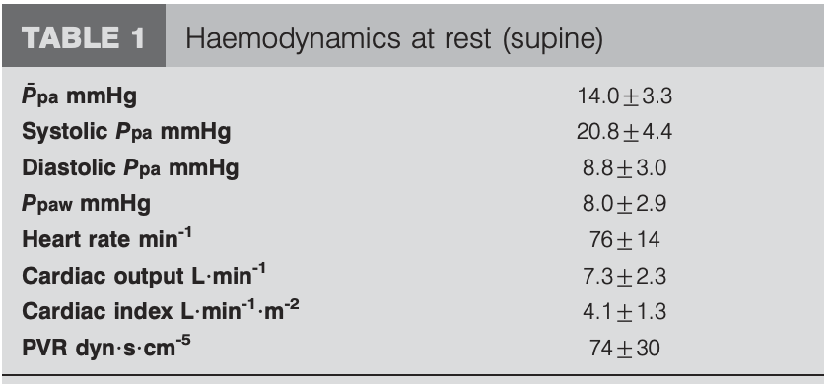
Hemodynamic Definition of PH
Classic Definition: Mean pulmonary arterial pressure of 25 mmHg or greater at rest during right heart catheterization (RHC)
Heterogenous group of disorders characterized by a mean pulmonary arterial pressure of 20 mmHg or greater at rest during right heart catheterization (RHC)

Slide 8
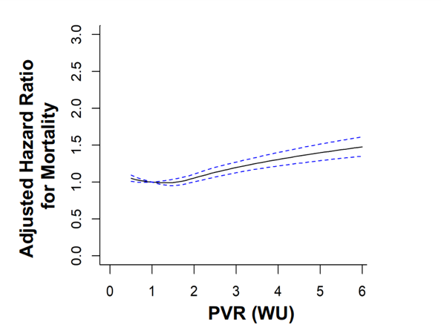
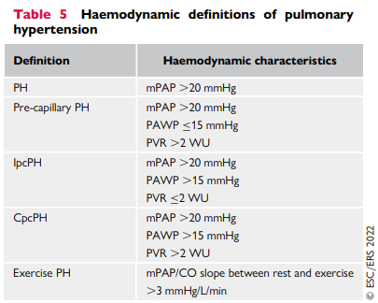
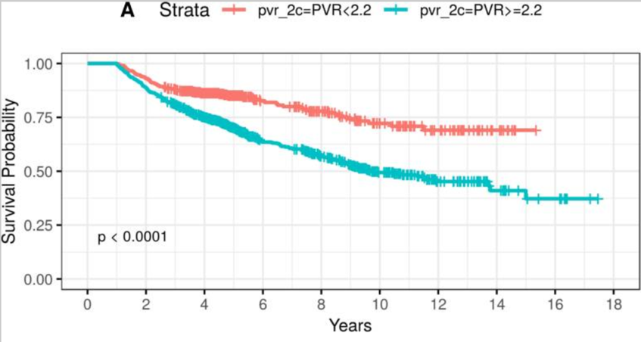
Press: 8/2022 ESC/ERS PH Guidelines

Slide 9
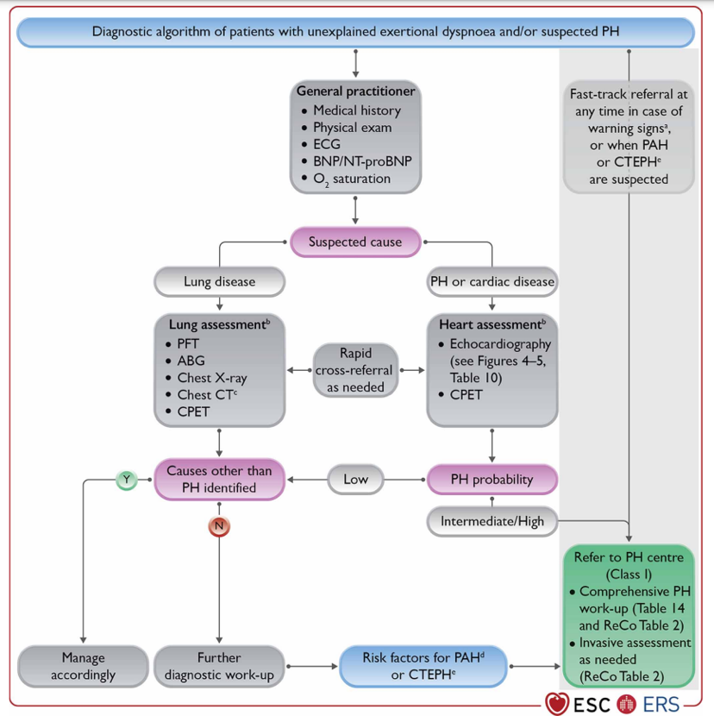
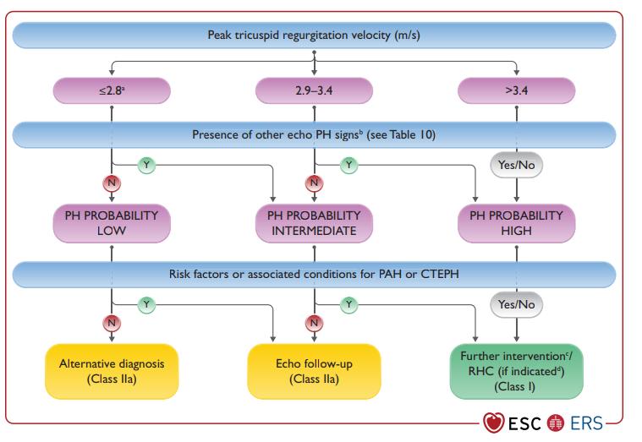
Improving Earlier Detection of PH

Slide 10
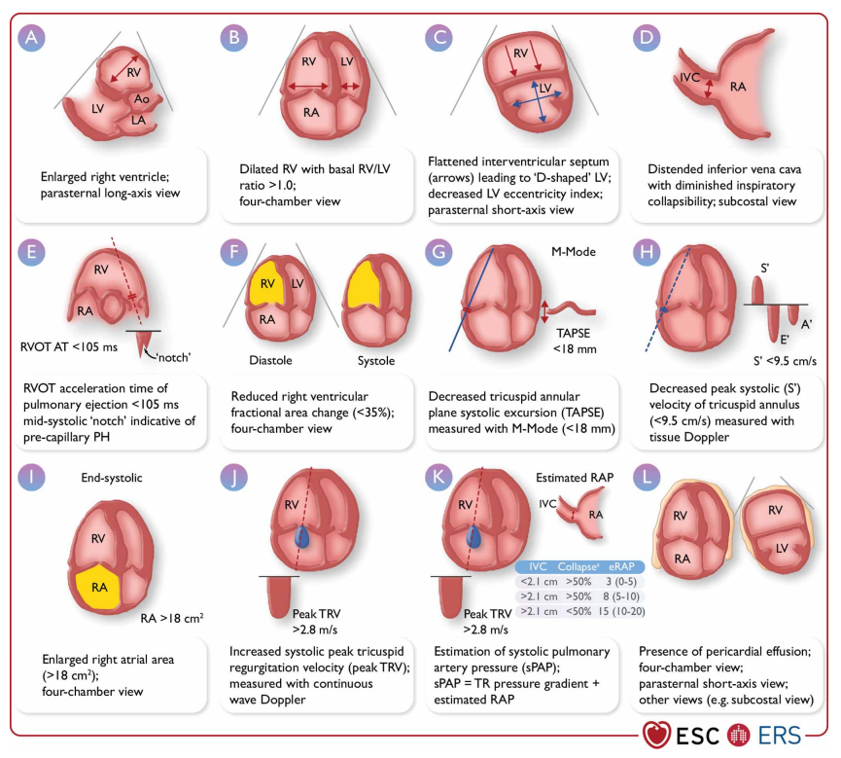
Pulmonary Hypertension AND Right Ventricle
The main concern of pulmonary hypertension is increased right ventricular afterload
Chronically elevated RV afterload can result in RV and PA uncoupling
  Ultimately resulting in RV systolic failure
Pulmonary hypertension can be suggested by echocardiography

Slide 11
New PVR Threshold & Implications for Clinical Practice?
Warrant close follow-up and surveillance
  Functional testing (6MWT, CPET)
  Echocardiography
  Perhaps repeat RHCs
Aggressive early modification of risk factors that predispose to PH
  OSA and PAP therapy
  Tobacco cessation
  Resting and exertional hypoxemia/supplemental oxygen
  Guideline therapy

Slide 12
Summary
PH defined as a mean PA pressure >20 mmHg
PAH = an elevation in mPA pressure, not due to elevated L-sided filling pressures, as a result of increased pulmonary vascular resistance
Fortunately, treatment options have improved and can impact patient outcomes and survival
  PAmean >20, PWp <15, and PVR >2

Slide 13
2022 Treatment Algorithm

Slide 14
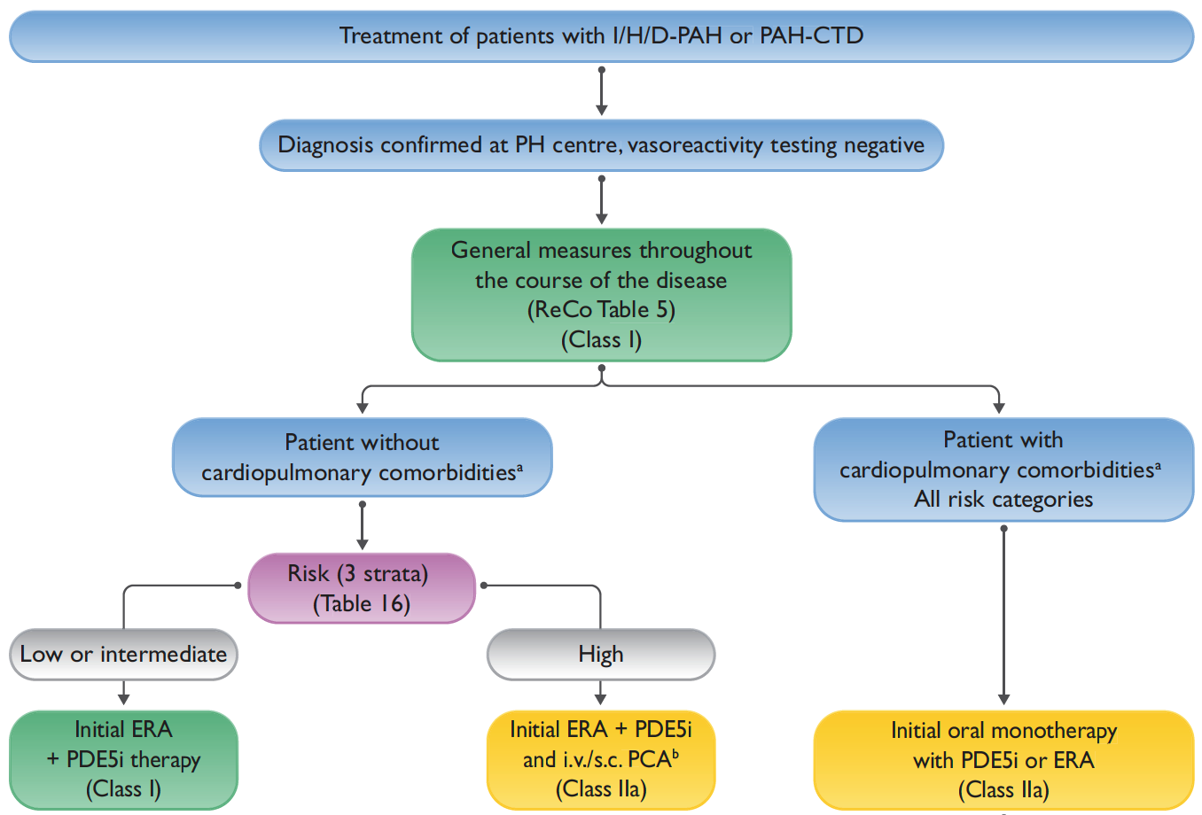
Treatment
Treatment algorithm

Slide 15
Risk Assessment to Guide Treatment
Three-factor assessment
  ESC/ERS Risk Tool
  REVEAL
  REVEAL Lite 2.0

Slide 16
Risk Assessment to Guide Treatment
Three-factor assessment
  ESC/ERS Risk Tool
  REVEAL
  REVEAL Lite 2.0
Low-Intermediate
  Upfront combination

Slide 17
Risk Assessment to Guide Treatment
Three-factor assessment
  ESC/ERS Risk Tool
  REVEAL
  REVEAL Lite 2.0
Low-Intermediate
  Upfront combination
High
  Upfront combination
  +Parenteral prostanoid

Slide 18
Risk Assessment to Guide Treatment
Three-factor assessment
  ESC/ERS Risk Tool
  REVEAL
  REVEAL Lite 2.0
Low-Intermediate
  Upfront combination
High
  Upfront combination
  +Parenteral prostanoid

Slide 19
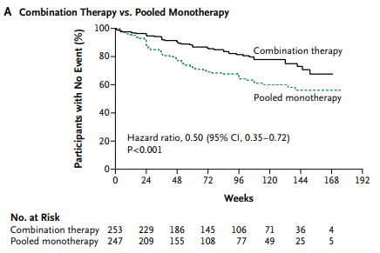
Upfront Combination Therapy: Low/Int Risk
AMBITION Trial
  PDE5 + ERA

Slide 20
Risk Assessment to Guide Treatment
Three-factor assessment
  ESC/ERS Risk Tool
  REVEAL
  REVEAL Lite 2.0
Low-Intermediate
  Upfront Combination
High
  Upfront combination
  + Parenteral prostanoid

Slide 21
Patients with Cardiopulmonary Comorbidities
CP comorbidities
  RF for HFpEF
    Obesity, DM,
    CHF, HTN

Slide 22
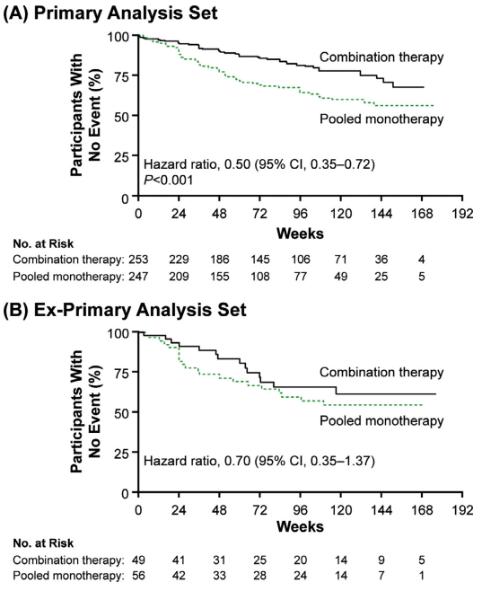
Upfront Combination Therapy
AMBITION trial with HFpEF RF
Patients with cardiopulmonary RF
  Worse baseline characteristics (age, 6MWD,
  comorbidities)
Lower benefit with upfront combination
Increase rates of discontinuation

Slide 23
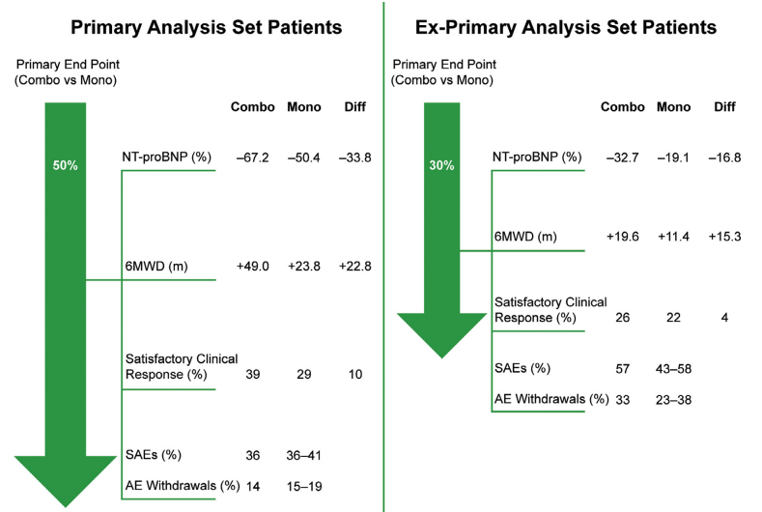
Upfront Combination Therapy
AMBITION trial with
HFpEF RF

Slide 24
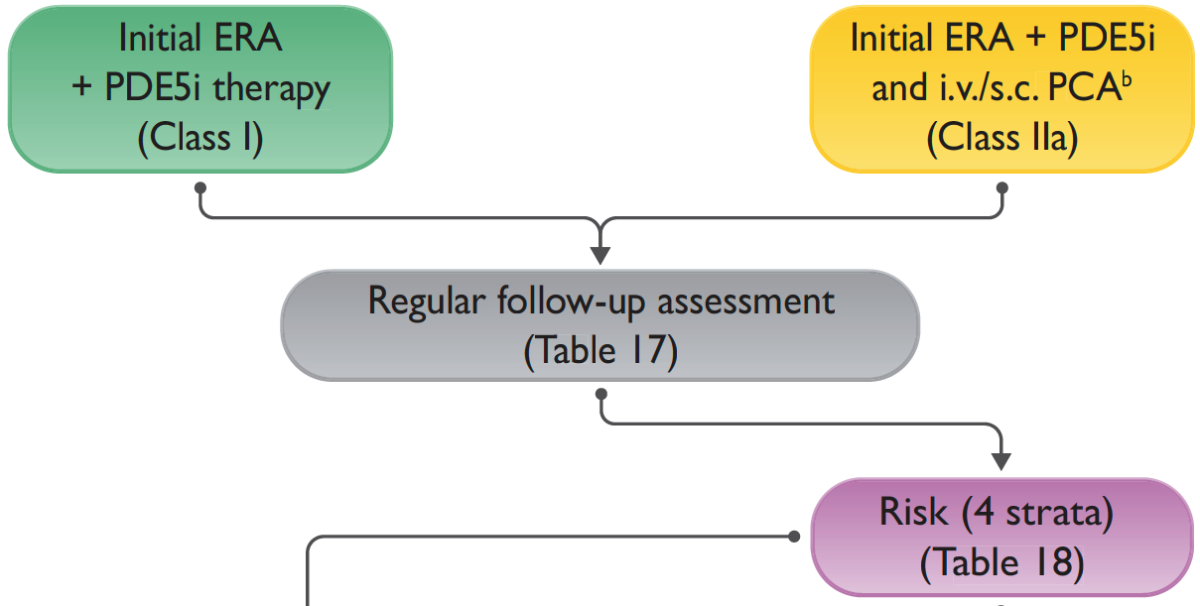
Treatment Goal Assessments

Slide 25
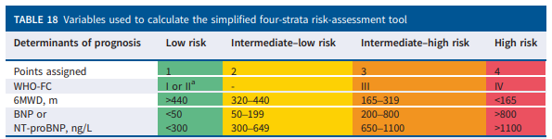
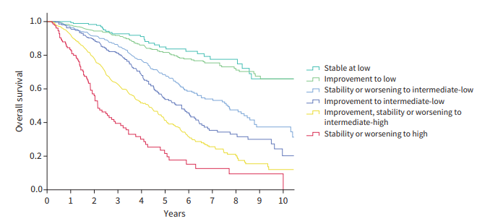
Treatment Goal Assessments
Four-strata
risk assessment
  WHO Function Class
  6MWD
  BNP / NT-proBNP

Slide 26
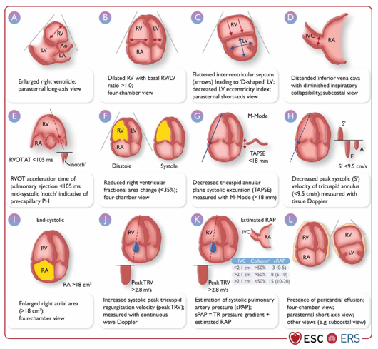
Conclusions
PH is a disease entity when the mean PA pressure is greater than 20 mmHg
PAH is the progressive primary
precapillary vasculopathy
Echocardiography is a good screening tool, RHC is diagnostic
  PAm >20, PWp <15, and PVR >2

Slide 27
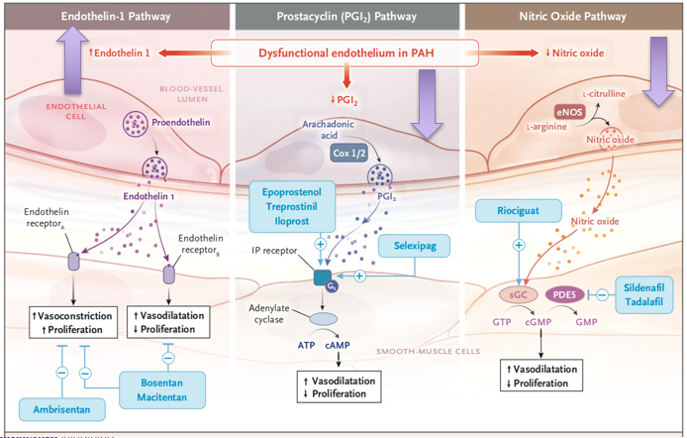
Conclusions
Treatment approach takes into account risk scores
Dual combination therapy for low-intermediate risk
Triple therapy including parenteral prostanoid for high-risk

Slide 28



Looking for more resources
on this topic?
CME/CE in minutes
Congress highlights
Late-breaking data
Quizzes
Webinars
In-person events
Slides & resources
www.MedEdOTG.com

