Slide 1
Risk Factors & Comorbidities Associated with AF
Christopher B. Granger, MD,
Donald F. Fortin, M.D. Distinguished Professor of Medicine, Professor of Nursing
Duke University Medical Center
Durham, NC

Slide 2



Resource Information
About This Resource
These slides are one component of a continuing education program available online at MedEd On The Go titled Treating and Preventing Clots: Anticoagulation in Atrial Fibrillation and Venous Thromboembolism
Program Learning Objectives:
Discuss appropriate diagnostic criteria and challenges faced in screening patients who may be at risk for blood clots due to either AF or VTE
Identify appropriate candidates for oral anticoagulation when AF or VTE is detected
Develop evidence-based, individualized treatment plans for patients with an indication for oral anticoagulation
MedEd On The Go®
www.mededonthego.com
This content or portions thereof may not be published, posted online or used in presentations without permission.
This content can be saved for personal use (non-commercial use only) with credit given to the resource authors.
To contact us regarding inaccuracies, omissions or permissions please email us at support@MedEdOTG.com

Slide 3
Disclaimer
The views and opinions expressed in this educational activity are those of the faculty and do not necessarily represent the views of Total CME, LLC, the CME providers, or the companies providing educational grants. This presentation is not intended to define an exclusive course of patient management; the participant should use their clinical judgment, knowledge, experience, and diagnostic skills in applying or adopting for professional use any of the information provided herein. Any procedures, medications, or other courses of diagnosis or treatment discussed or suggested in this activity should not be used by clinicians without evaluation of their patient's conditions and possible contraindications or dangers in use, review of any applicable manufacturer’s product information, and comparison with recommendations of other authorities. Links to other sites may be provided as additional sources of information.

Slide 4
Key Issues
AF is a condition in context of comorbidities
Managing comorbidities improves health in people with AF
  Burden of AF, quality of life, risk of stroke, risk of death
Managing comorbidities reduces risk of developing AF and the burden of AF
An integrated approach is key to treating symptoms and risk of stroke and heart failure for those with AF

Slide 5
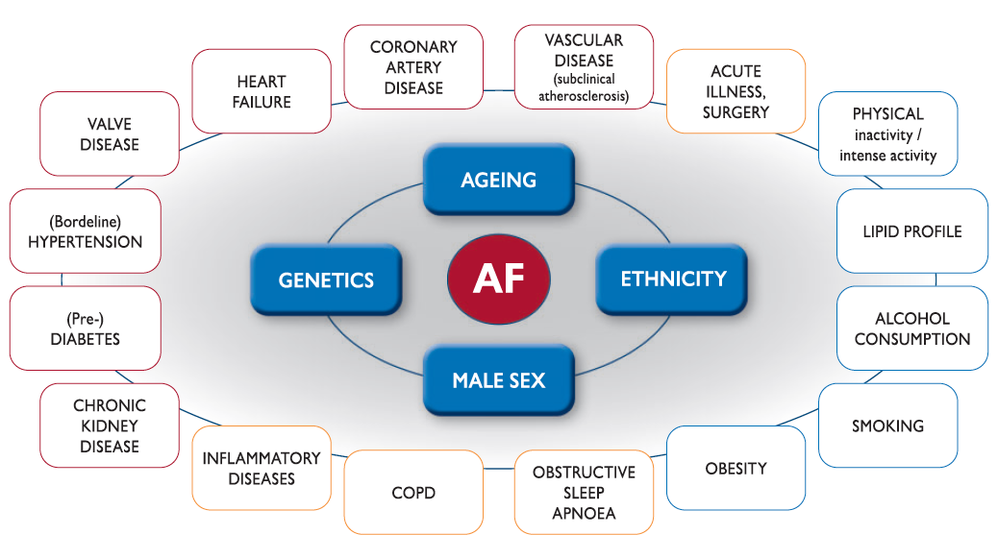
Summary of Risk Factors for Incident AF

Slide 6
Weight loss for obesity, moderate exercise, controlling blood pressure, treating HF with GDMT (including MRAs), are stressed
as opportunities to reduce AF risk

Slide 7
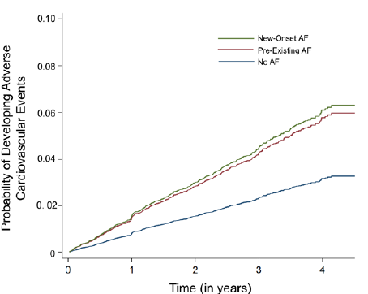
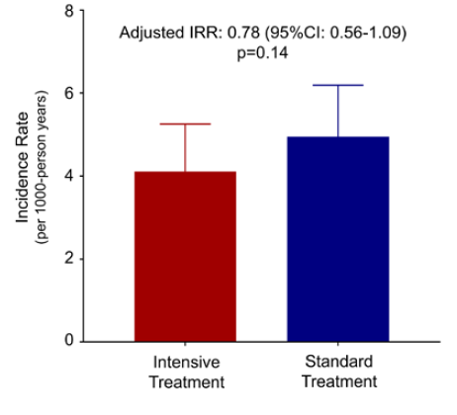
Incidence and Implications of AF/Flutter in Hypertension: Insights from the SPRINT Trial

Slide 8
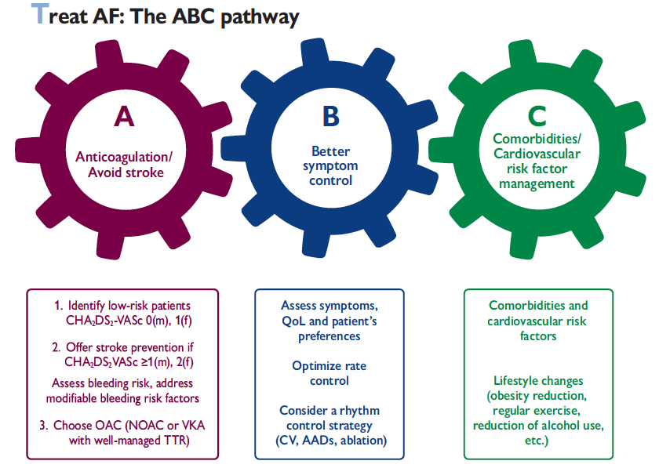
Management of AF

Slide 9
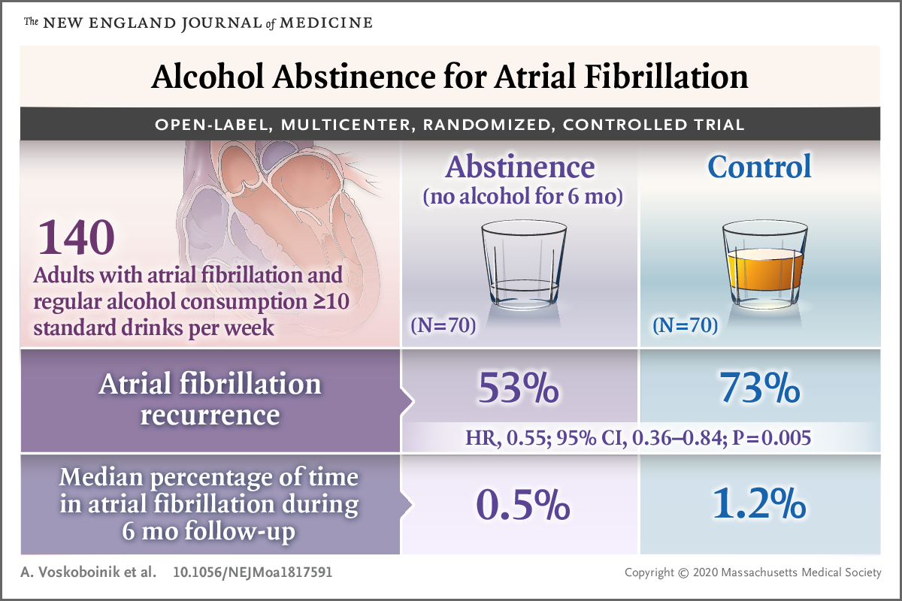

Slide 10
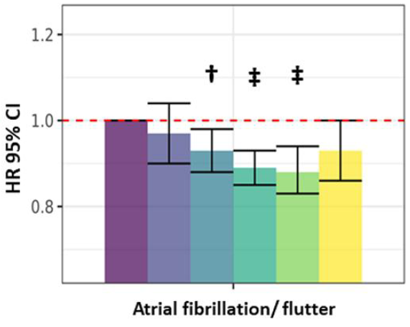
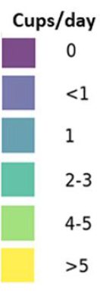
The impact of coffee subtypes on incident cardiovascular disease, arrhythmias, and mortality: long-term outcomes from the UK Biobank
David Chieng^{1,2,3}, Rodrigo Canovas^{4,5}, Louise Segan^{1,2,3}, Hariharan Sugumar^{1,2,3}, Aleksandr Voskoboinik^{1,2,3}, Sandeep Prabhu^{1,2,3}, Liang-Han Ling^{1,2,3}, Geoffrey Lee^{3,6}, Joseph B. Morton^{3,6}, David M. Kaye^{1,2,7}, Jonathan M. Kalman^{3,6,7}, and Peter M. Kistler^{1,2,3,7}*

Slide 11
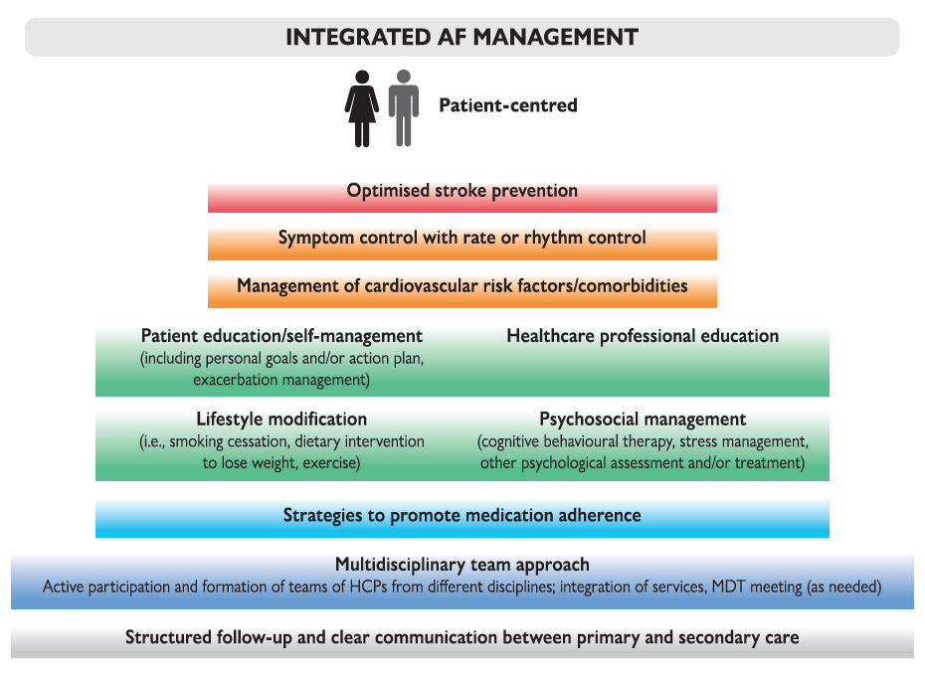
Components of Integrated AF Management

Slide 12
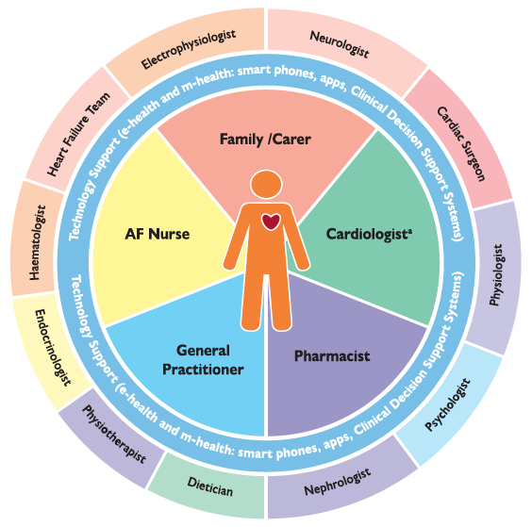
Integrated AF Management Team

Slide 13
Summary
Comorbidities are common in patients with AF and managing them improves AF-related outcomes
Most important are older age, renal disease, heart failure, frailty
Treatment effects of NOACs are generally consistent across these major subgroups
DOACs, and in particular apixaban, have consistent benefits with respect to lower bleeding risk in high-risk subgroups
Education is a powerful tool to close the gap between high quality evidence and clinical practice

Slide 14
For a 82 year-old man with paroxysmal AF with symptoms of SOB, EF 35%, hypertension, and high proBNP, which of the following may not reduce the impact of AF on symptoms, heart failure, stroke?
Control blood pressure
Treat with RASS inhibitor (ARB, sacubitril valsartan)
Reduce alcohol intake
Treat with AF ablation
Treat with amiodarone
Treat with oral anticoagulation

Slide 15



Looking for more resources
on this topic?
CME/CE in minutes
Congress highlights
Late-breaking data
Quizzes
Webinars
In-person events
Slides & resources
www.MedEdOTG.com

