Slide 1
Case Time!
VTE Prophylaxis
Post-Hip Replacement
Victor Tapson, MD
Professor of Medicine
Pulmonary/Critical Care
Cedars-Sinai Medical Center
VP Medical Affairs
Inari Medical
Los Angeles, CA

Slide 2



Resource Information
About This Resource
These slides are one component of a continuing education program available online at MedEd On The Go titled Primary Prevention, Initial Treatment & Management of VTE, Secondary VTE Prevention Strategies
Program Learning Objectives:
Discuss patient populations that are particularly susceptible to blood clot development, emphasizing the importance of risk assessment and stratification for the primary prevention of VTE and the secondary prevention of recurrent VTE
Illustrate how to implement evidence-based medicine, clinical guideline statements, and real-world clinical data in clinical practice to improve outcomes for primary prevention of VTE, initial treatment and management of VTE, and the secondary prevention of recurrent VTE
MedEd On The Go®
www.mededonthego.com
This content or portions thereof may not be published, posted online or used in presentations without permission.
This content can be saved for personal use (non-commercial use only) with credit given to the resource authors.
To contact us regarding inaccuracies, omissions or permissions please email us at support@MedEdOTG.com

Slide 3
Disclaimer
The views and opinions expressed in this educational activity are those of the faculty and do not necessarily represent the views of Total CME, LLC, the CME providers, or the companies providing educational grants. This presentation is not intended to define an exclusive course of patient management; the participant should use their clinical judgment, knowledge, experience, and diagnostic skills in applying or adopting for professional use any of the information provided herein. Any procedures, medications, or other courses of diagnosis or treatment discussed or suggested in this activity should not be used by clinicians without evaluation of their patient's conditions and possible contraindications or dangers in use, review of any applicable manufacturer’s product information, and comparison with recommendations of other authorities. Links to other sites may be provided as additional sources of information.

Slide 4
Total hip replacement two weeks ago...
76-year-old obese man s/p left THR for severe degenerative arthritis
S/p CABG 4 years prior – poor mobility, but no current CV symptoms
VTE prophylaxis plan: ASA 81 mg once daily x 30 days
Two weeks after surgery: noted increasing swelling of left calf
The following morning: related dyspnea when walking to mailbox
Presented to ED
CT scan is performed followed by bilateral leg ultrasound
Low-risk acute PE is diagnosed, as well as acute DVT

Slide 5
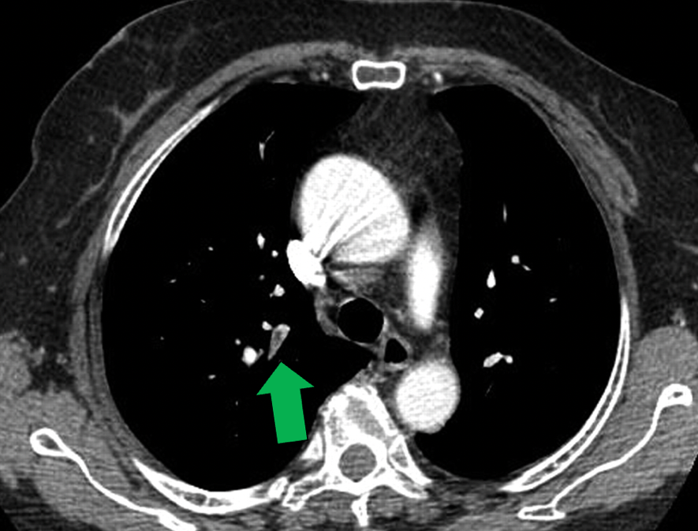
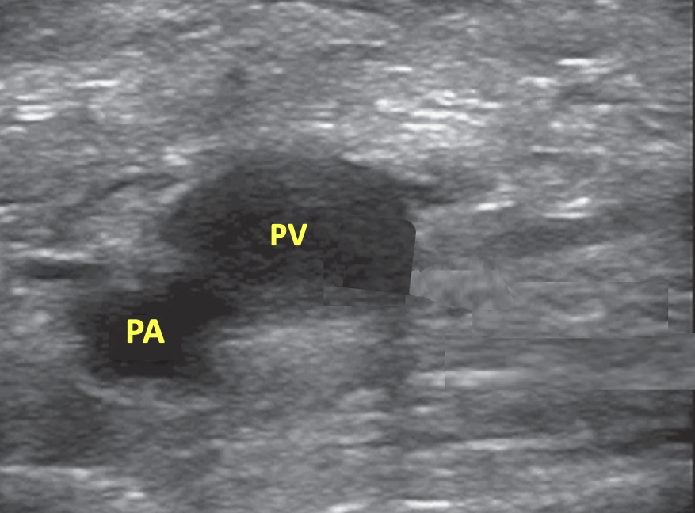
The PV is noncompressible.
It is slightly hyperechoic.
Acute pulmonary embolism
Acute DVT – posterior tibial, popliteal, and soleal veins
Rivaroxaban initiated: Plan is 15 mg po twice daily x 3 weeks followed by 20 mg once daily (with food)
At 6 months, he had gained 35 lbs and BMI was 42. Activity nearly always was sitting on couch all day
Repeat leg ultrasound showed poor vein recanalization and evidence of chronic thrombus
Rivaroxaban was decreased to 10 mg once daily (with or without food) and continued

Slide 6
QUESTIONS
What are the supporting data for the treatment plan?
Why did this VTE event occur?
How should patients be prophylaxed for VTE after THR?

Slide 7
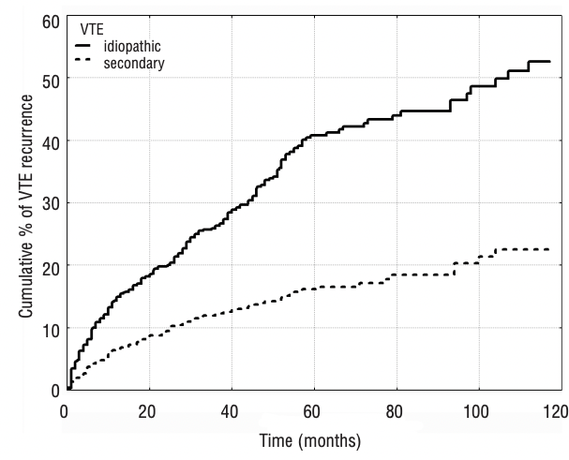
Cumulative Incidence of Recurrent VTE in Patients with Idiopathic (unprovoked) and Secondary (provoked) VTE
idiopathic (unprovoked)
Secondary (provoked)

Slide 8
Cumulative Incidence of Recurrent VTE in Patients with Idiopathic (unprovoked) and Secondary (provoked) VTE
idiopathic (unprovoked)
Secondary (provoked)
Provoked VTE – recurrence rate at 2 years = 10%

Slide 9
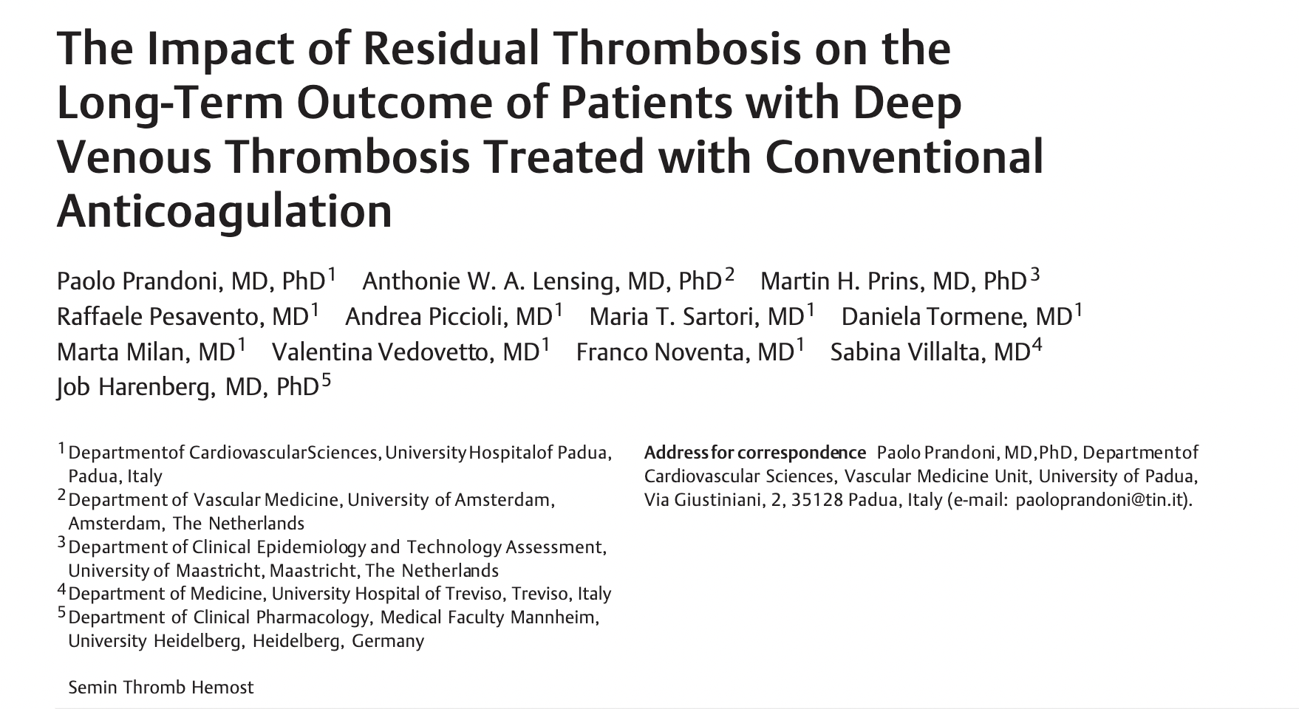
In conclusion:
RVT doubles risk of recurrent VTE, PTS, and arterial thrombosis
Males, previous VTE, and extensive thrombosis are independent risk factors for RVT development
2015

Slide 10

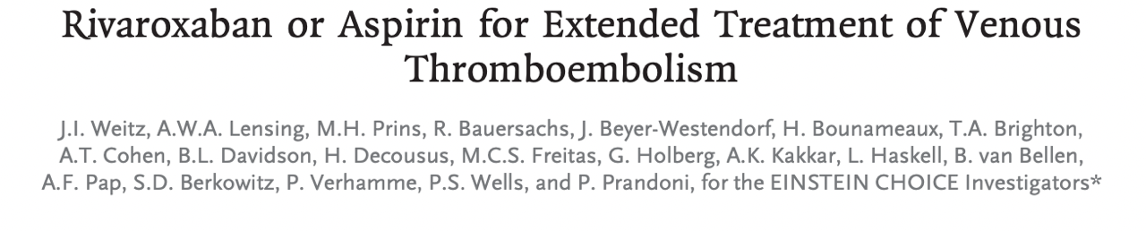
EINSTEIN CHOICE
3,365 patients with acute VTE
Primary efficacy outcome = symptomatic recurrent fatal or nonfatal VTE
Principal safety outcome = major bleeding.
Double-blind RCT
Randomized to continue rivaroxaban 20 mg, drop to 10 mg, or change to ASA at 6-12 months

Slide 11
EINSTEIN CHOICE
3,365 patients with acute VTE
Primary efficacy outcome = symptomatic recurrent fatal or nonfatal VTE
Principal safety outcome = major bleeding.
Double-blind RCT
Randomized to continue rivaroxaban 20 mg, drop to 10 mg, or change to ASA at 6-12 months
DRUG VTE Recurrence Major Bleeding CRNM bleeding
Rivaroxaban 10 mg 1.2% 0.4% 2.0%
ASA 100 mg (no placebo) 4.2% 0.3% 1.8%

Slide 12
EINSTEIN CHOICE
WE CAN SAFELY TREAT PATIENTS WITH EXTENDED ANTICOAGULATION!
3,365 patients with acute VTE
Primary efficacy outcome = symptomatic recurrent fatal or nonfatal VTE
Principal safety outcome = major bleeding.
Double-blind RCT
Randomized to continue rivaroxaban 20 mg, drop to 10 mg, or change to ASA at 6-12 months
DRUG VTE Recurrence Major Bleeding CRNM bleeding
Rivaroxaban 10 mg 1.2% 0.4% 2.0%
ASA 100 mg (no placebo) 4.2% 0.3% 1.8%

Slide 13
CASE REVIEW:
Why did the VTE event occur?
The patient was compliant with ASA
The VTE prophylaxis medical literature were reviewed
In the 1960s, the modern era of joint arthroplasty was launched
More than half a century later, in the 2020s, an estimated 1.5 million THA and TKA procedures are performed each year in the U.S.
Death from PE (previously 3% after THA and TKA) now affects less than 0.2% of patients, indicating improved perioperative care and routine VTE thromboprophylaxis

Slide 14
Risk of Thrombosis:
Major orthopedic procedures carry a high baseline risk for symptomatic VTE (approximately 4-5%), which can be increased further by the presence of additional procedure- and patient-related factors
Additional factors:
Age greater than 75 years (particularly ≥85 years)
Poor ambulation (prior to surgery)
Obesity
Cardiovascular disease
Greater extent and longer duration of surgery
General anesthesia (as opposed to spinal anesthesia)
Prolonged period of immobilization and/or casting postoperatively
Bilateral total joint arthroplasty (as opposed to unilateral arthroplasty)
Many orthopedic surgeons now prescribe ASA for VTE prophylaxis after THA/TKA
The strength of evidence supporting ASA, compared with anticoagulants is controversial

Slide 15

Extended duration rivaroxaban versus short-term enoxaparin for the prevention of venous thromboembolism after total hip arthroplasty: A double-blind, randomised controlled trial
CONCLUSION:
Extended thromboprophylaxis with rivaroxaban was significantly more effective than short-term enoxaparin plus placebo for the prevention of VTE, including symptomatic events, in patients undergoing THA

Slide 16

Aspirin or Rivaroxaban for VTE Prophylaxis after Hip or Knee Arthroplasty
METHODS
Multicenter, double-blind, RCT in patients undergoing THA or TKA
All patients received once-daily oral rivaroxaban (10 mg) until POD #5
They were then randomized to continue rivaroxaban or switch to ASA (81 mg daily) for an additional 9 days after TKA or for 30 days after THA
They were followed for 90 days for symptomatic VTE and bleeding complications

Slide 17
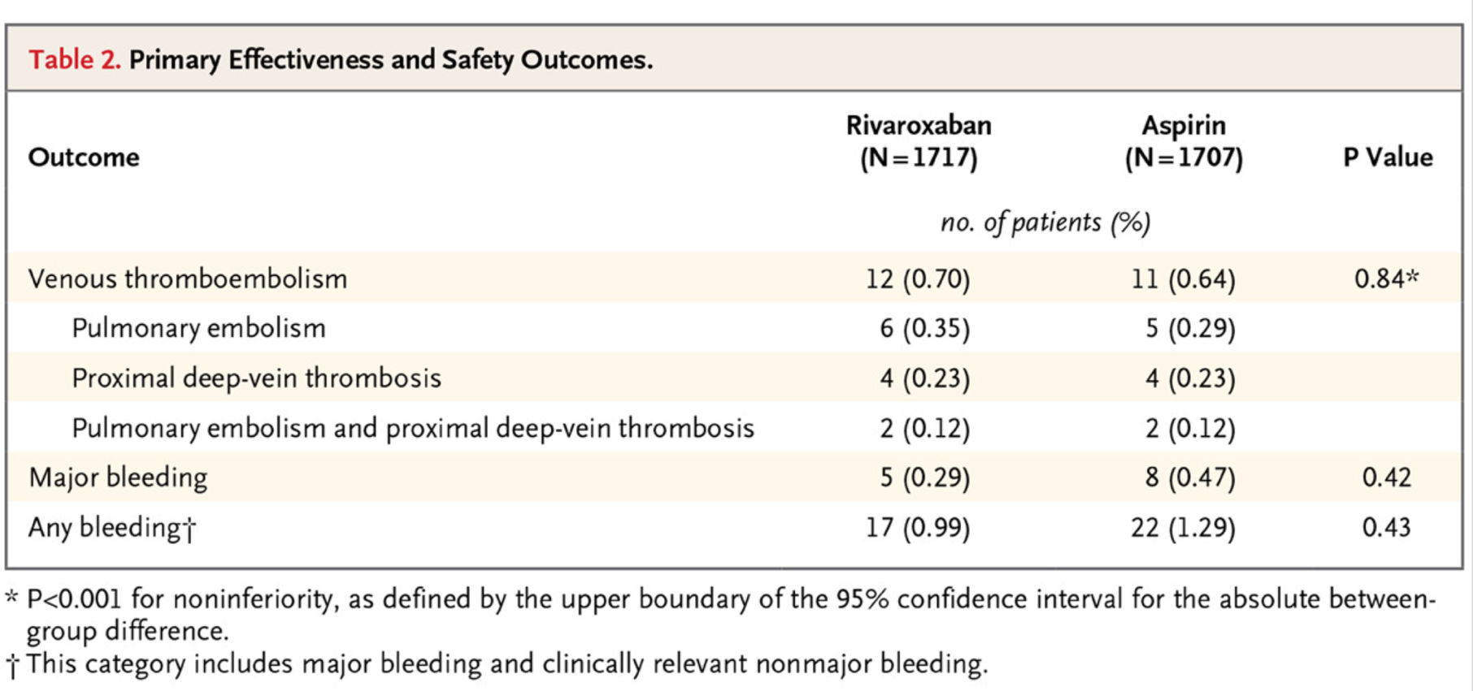
Aspirin or Rivaroxaban for VTE Prophylaxis after Hip or Knee Arthroplasty

Slide 18
Aspirin or Rivaroxaban for VTE Prophylaxis after Hip or Knee Arthroplasty
All patients received once-daily oral rivaroxaban (10 mg) until POD #5, then...

Slide 19
Aspirin or Rivaroxaban for VTE Prophylaxis after Hip or Knee Arthroplasty
CONCLUSIONS
Among patients who received 5 days of rivaroxaban prophylaxis after THA or TKA, extended prophylaxis with aspirin was not significantly different from continuing rivaroxaban in the prevention of symptomatic VTE

Slide 20
TIMING OF VTE PROPHYLAXIS IN THE SETTING OF THA/TKA:
Rivaroxaban is generally started postoperatively 6 to 12 hours or more after surgery, if the patient can eat (if not, LMWH SC should be administered until the patient can eat
For total hip arthroplasty:
Extend thromboprophylaxis for a total of 35 days
For most patients, the same agent (DOAC) is used for the entire 35-day course
In select patients who do not have additional VTE risk factors, some clinicians support switching to ASA after 5 to 10 days of rivaroxaban, for the remainder of the 35 days
Lower-risk patients are those who fill all of the following criteria:
  No other risk factors for VTE
  No other indications for long-term anticoagulation
  No lower limb or hip fracture in previous three months
  Surgery is elective and unilateral
  Ambulatory within 24 hours after surgery
THA is a high-risk setting for acute VTE. The risk of bleeding decreases over time
Many surgeons prefer to continue the DOAC for the 35-day period
TIMING OF VTE PROPHYLAXIS IN THE SETTING OF THA/TKA:
Rivaroxaban is generally started postoperatively 6 to 12 hours or more after surgery, if the patient can eat (if not, LMWH SC should be administered until the patient can eat

Slide 21
Choosing an Agent for VTE Prophylaxis
After THA:
Many believe that ASA should not be used as the sole initial agent for prophylaxis in the early postoperative period until it is better supported with large, well-conducted, randomized trial data before this approach should be
routinely used
This recommendation is in contrast with the practice of many orthopedic surgeons who commonly use ASA as the sole agent for VTE prophylaxis, viewing it as an effective and safe agent

Slide 22
CONCLUSIONS
Major orthopedic procedures such as THA and TKA are associated with a high risk for symptomatic VTE (approximately 4-5%), which can be increased further by the presence of additional procedure- and patient-related factors
The DOACs have proven effective in prevention of acute VTE in this setting
Rivaroxaban 10 mg once daily has not only proven effective in this setting but has also been shown to be effective when prescribed for the first 5 days after THA or THK followed by ASA 81 mg once daily
Our patient was at particularly high risk for acute VTE after THA; he was greater than 75 years old, was obese, had a history of CAD, and poor mobility prior to the THA procedure. He failed once-daily ASA therapy after his THA
While rivaroxaban 10 mg once daily may be considered for the first 5 days after THA followed by ASA, unless patients meet lower risk criteria for VTE, rivaroxaban should be considered for the full duration of prophylaxis

Slide 23



Looking for more resources
on this topic?
CME/CE in minutes
Congress highlights
Late-breaking data
Quizzes
Webinars
In-person events
Slides & resources
www.MedEdOTG.com

