Slide 1
Mrs. V.T. Elizabeth:
A Case Study on the Secondary Prevention of VTE
Deborah Siegal, MD, MSc, FRCPC
Tier 2 Canada Research Chair in Anticoagulant Management of Cardiovascular Disease
Associate Professor, University of Ottawa
Scientist, Ottawa Hospital Research Institute
Ottawa, Canada

Slide 2



Resource Information
About This Resource
These slides are one component of a continuing education program available online at MedEd On The Go titled Primary Prevention, Initial Treatment & Management of VTE, Secondary VTE Prevention Strategies
Program Learning Objectives:
Discuss patient populations that are particularly susceptible to blood clot development, emphasizing the importance of risk assessment and stratification for the primary prevention of VTE and the secondary prevention of recurrent VTE
Illustrate how to implement evidence-based medicine, clinical guideline statements, and real-world clinical data in clinical practice to improve outcomes for primary prevention of VTE, initial treatment and management of VTE, and the secondary prevention of recurrent VTE
MedEd On The Go®
www.mededonthego.com
This content or portions thereof may not be published, posted online or used in presentations without permission.
This content can be saved for personal use (non-commercial use only) with credit given to the resource authors.
To contact us regarding inaccuracies, omissions or permissions please email us at support@MedEdOTG.com

Slide 3
Disclaimer
The views and opinions expressed in this educational activity are those of the faculty and do not necessarily represent the views of Total CME, LLC, the CME providers, or the companies providing educational grants. This presentation is not intended to define an exclusive course of patient management; the participant should use their clinical judgment, knowledge, experience, and diagnostic skills in applying or adopting for professional use any of the information provided herein. Any procedures, medications, or other courses of diagnosis or treatment discussed or suggested in this activity should not be used by clinicians without evaluation of their patient's conditions and possible contraindications or dangers in use, review of any applicable manufacturer’s product information, and comparison with recommendations of other authorities. Links to other sites may be provided as additional sources of information.

Slide 4
Case
68-year-old woman with unprovoked pulmonary embolism and proximal DVT
Completed 5.5 months of therapeutic anticoagulation with rivaroxaban
Assessed in clinic for consideration of ongoing anticoagulation
Guideline-directed cancer screening up to date
No complications of therapy
Investigations
Hypertension, dyslipidemia, osteoarthritis, cholecystectomy
Hemoglobin 12.6 g/dL
Medications
perindopril, hydrochlorothiazide, rosuvastatin, acetaminophen prn
BMI 29
Platelets 226x10⁹/L
Creatinine clearance 58 mL/min
Medical History

Slide 5
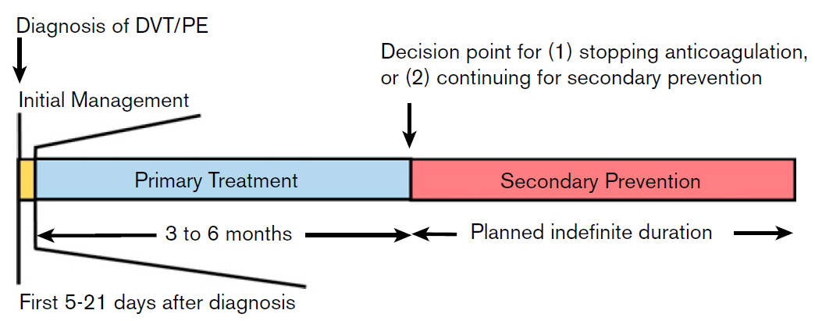
Timeframe for Decisions After VTE Diagnosis

Slide 6
Anticoagulation Framework
Completion of primary treatment for DVT and/or PE (3 to 6 months of anticoagulation)
Assessment of provoking factors
Transient
Persistent
Unprovoked

Slide 7
Anticoagulation Framework
Completion of primary treatment for DVT and/or PE (3 to 6 months of anticoagulation)
Assessment of provoking factors
Transient
Persistent
Unprovoked
Determines risk of recurrence off anticoagulation and informs ongoing treatment

Slide 8
Anticoagulation Framework
Completion of primary treatment for DVT and/or PE (3 to 6 months of anticoagulation)
Assessment of provoking factors
Transient
Persistent
Unprovoked
Determines risk of recurrence off anticoagulation and informs ongoing treatment
Up to 50% of events

Slide 9
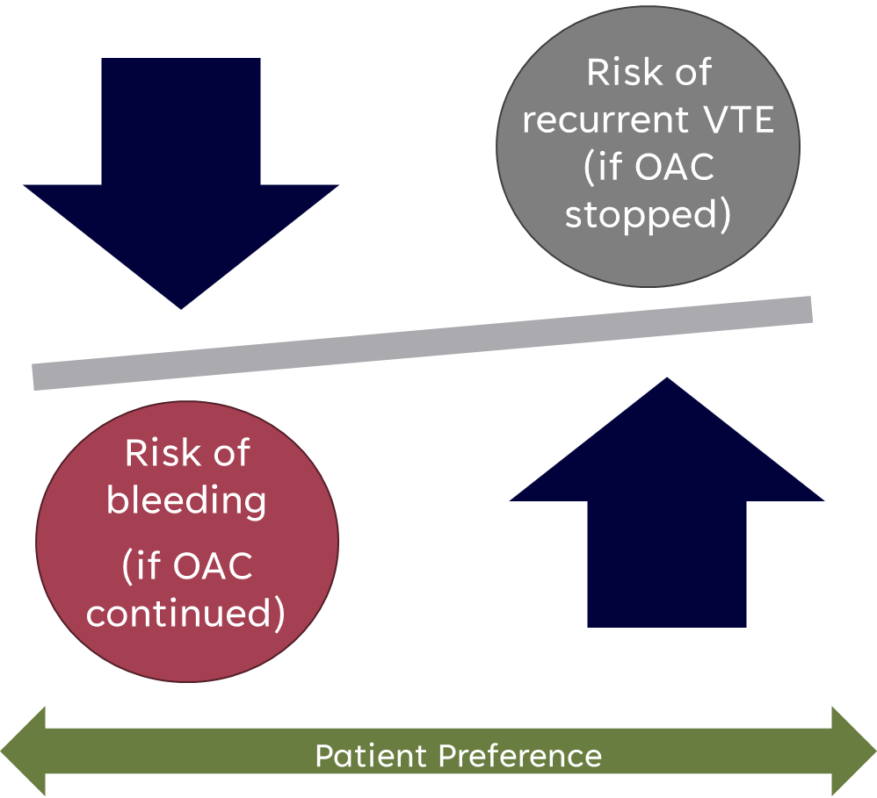
Net Clinical Benefit of Ongoing Treatment
After completion of primary treatment

Slide 10
Net Clinical Benefit of Ongoing Treatment
After completion of primary treatment
Identify patients
who would benefit
from long-term
anticoagulation

Slide 11
Provoking Risk Factors for VTE
Transient Risk Factors
MAJOR Risk Factor (occurs within 3 mo)
Persistent Risk Factors
Active cancer (ongoing chemo; recurrent or progressive disease)
Surgery, gen anesthesia more than 30 min
Confined to hospital bed 3 or more days with acute illness
Cesarean section
MINOR Risk Factor (occurs within 2 mo)
Estrogen therapy (OCP, HRT)
Pregnancy, puerperium
Confined to bed out of hospital 3 or more days with acute illness
Leg injury, reduced mobility 3 or more days
Inflammatory bowel disease
Autoimmune disorder (e.g., antiphospholipid syndrome, rheumatoid arthritis)
Chronic infection
Chronic immobility (e.g., spinal cord injury)

Slide 12
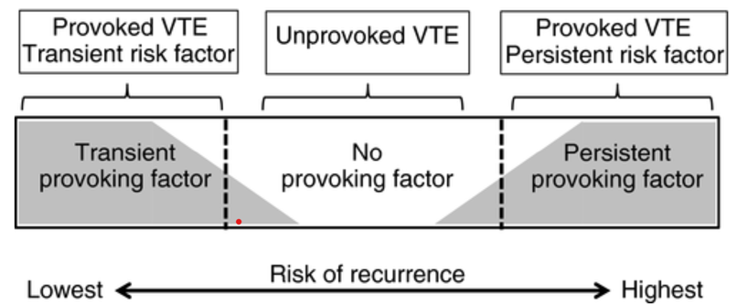
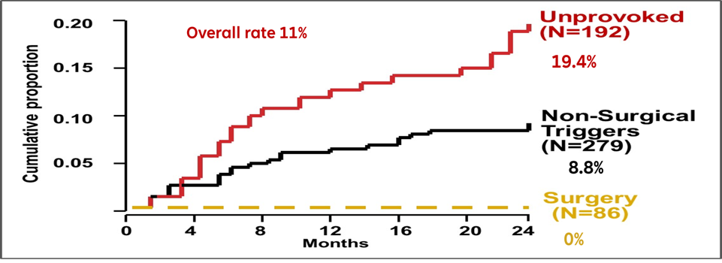
Impact of Provoking Risk Factor
Excluded malignancy, APS, offered thrombophilia testing

Slide 13
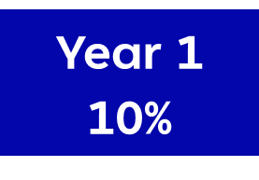
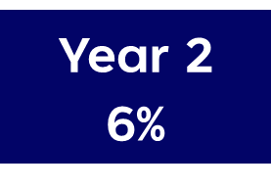
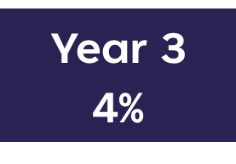
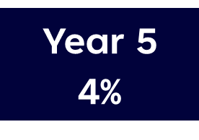




VTE Recurrence After Treatment for Unprovoked VTE
After discontinuation of anticoagulation
20%
25%
10%
16%

Slide 14
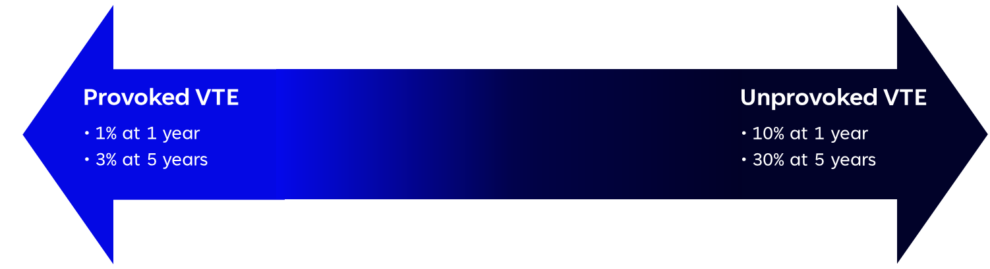
What is the Threshold to Continue Treatment?
After completion of primary treatment

Slide 15
What is the Threshold to Continue Treatment?
After completion of primary treatment
Accepted threshold 5% per year?

Slide 16
Clinical Tools Predict Risk of Recurrent VTE
DASH Prediction Score
Men continue and HERDOO2 for women
Risk Factor | Points
Abnormal D-dimer | 2
Age ≤ 50 years | 1
Male patient | 1
Hormone use at VTE onset (if female) | -2
Risk Factor | Points
“HER” (hyperpigmentation, edema, redness | 1
D-Dimer ≥ 250 ug/L | 1
Obesity (BMI ≥ 30) | 1
Older age (≥ 65 yrs) | 1
Points | Annual Rate | Points | Annual Rate
≤ -1 | <2% | 2 | 6.3%
0 | 2.4% | 3 | 10.8%
1 | 3.9% | 4 | 19.9%
Risk Category | Points | Absolute risk (95%CI)
Low Risk | 0 – 1 | 3% per pt yr (1.8% - 4.8%)
High risk | ≥2 | 8% per pt yr (5.2% - 11.8%)

Slide 17

Recommendations for Extended Anticoagulation
X
Major transient risk factor
Recommend AGAINST OFFERING extended-phase anticoagulation
Strong recommendation, moderate-certainty evidence
Minor transient risk factor
Suggest AGAINST OFFERING extended-phase anticoagulation
Weak recommendation, moderate-certainty evidence
Unprovoked or persistent risk factor
Recommend OFFERING extended-phase anticoagulation with a DOAC
Strong recommendation, moderate-certainty evidence
Unprovoked or persistent risk factor and cannot receive DOAC
Suggest OFFERING extended-phase anticoagulation with a VKA
Weak recommendation, moderate-certainty evidence
X
✓
✓

Slide 18

Recommendations for Extended Anticoagulation
Transient provoking risk factor
Patients with DVT and/or PE provoked by a transient risk factor typically do not require antithrombotic therapy after completion of primary treatment
Chronic provoking risk factor
Suggest indefinite antithrombotic therapy over stopping anticoagulation
Conditional recommendation, moderate certainty evidence of effects
Unprovoked
Suggest indefinite antithrombotic therapy over stopping anticoagulation
Conditional recommendation, moderate certainty evidence of effects
X
✓
✓

Slide 19


Summary of Recommendations for Extended Treatment
After completion of primary treatment
ASH Guidelines
CHEST Guidelines
Major transient risk factors
Minor transient risk factor
Unprovoked or persistent risk factor
Chronic provoking risk factor
Unprovoked
Transient risk factor
X
X
X
✓
✓
✓

Slide 20


Extended Treatment: DOAC Dose Intensity
In patients offered extended-phase anticoagulation…
Suggest the use of reduced-dose apixaban or rivaroxaban over full-dose apixaban or rivaroxaban
Weak recommendation, very low-certainty evidence
Considerations:
Choice of drug and dose is informed by BMI, renal function, adherence to dosing regimen, cost
For patients with DVT and/or PE who will continue a DOAC for secondary prevention…
Suggest using a standard-dose DOAC or a lower-dose DOAC
Conditional recommendation, moderate certainty evidence
Considerations:
Lower-dose DOAC regimens include rivaroxaban 10 mg daily, or apixaban 2.5 mg twice daily

Slide 21



Looking for more resources
on this topic?
CME/CE in minutes
Congress highlights
Late-breaking data
Quizzes
Webinars
In-person events
Slides & resources
www.MedEdOTG.com

