Slide 1
How Do We Effectively Integrate the Latest VTE Treatment and Secondary Prevention Guidelines Into Clinical Practice?
Deborah Siegal, MD, MSc, FRCPC
Tier 2 Canada Research Chair in Anticoagulant Management of Cardiovascular Disease
Associate Professor, University of Ottawa
Scientist, Ottawa Hospital Research Institute
Ottawa, Canada

Slide 2



Resource Information
About This Resource
These slides are one component of a continuing education program available online at MedEd On The Go titled Primary Prevention, Initial Treatment & Management of VTE, Secondary VTE Prevention Strategies
Program Learning Objectives:
Discuss patient populations that are particularly susceptible to blood clot development, emphasizing the importance of risk assessment and stratification for the primary prevention of VTE and the secondary prevention of recurrent VTE
Illustrate how to implement evidence-based medicine, clinical guideline statements, and real-world clinical data in clinical practice to improve outcomes for primary prevention of VTE, initial treatment and management of VTE, and the secondary prevention of recurrent VTE
MedEd On The Go®
www.mededonthego.com
This content or portions thereof may not be published, posted online or used in presentations without permission.
This content can be saved for personal use (non-commercial use only) with credit given to the resource authors.
To contact us regarding inaccuracies, omissions or permissions please email us at support@MedEdOTG.com

Slide 3
Disclaimer
The views and opinions expressed in this educational activity are those of the faculty and do not necessarily represent the views of Total CME, LLC, the CME providers, or the companies providing educational grants. This presentation is not intended to define an exclusive course of patient management; the participant should use their clinical judgment, knowledge, experience, and diagnostic skills in applying or adopting for professional use any of the information provided herein. Any procedures, medications, or other courses of diagnosis or treatment discussed or suggested in this activity should not be used by clinicians without evaluation of their patient's conditions and possible contraindications or dangers in use, review of any applicable manufacturer’s product information, and comparison with recommendations of other authorities. Links to other sites may be provided as additional sources of information.

Slide 4
VTE
Includes DVT and PE (and superficial vein thrombosis)
Most common cardiovascular illness after acute coronary syndrome and stroke
Annual incidence 1 to 2 per 1,000 persons
90% of DVT begin in the calf
25% extend to proximal veins
40-50% risk of PE if untreated

Slide 5
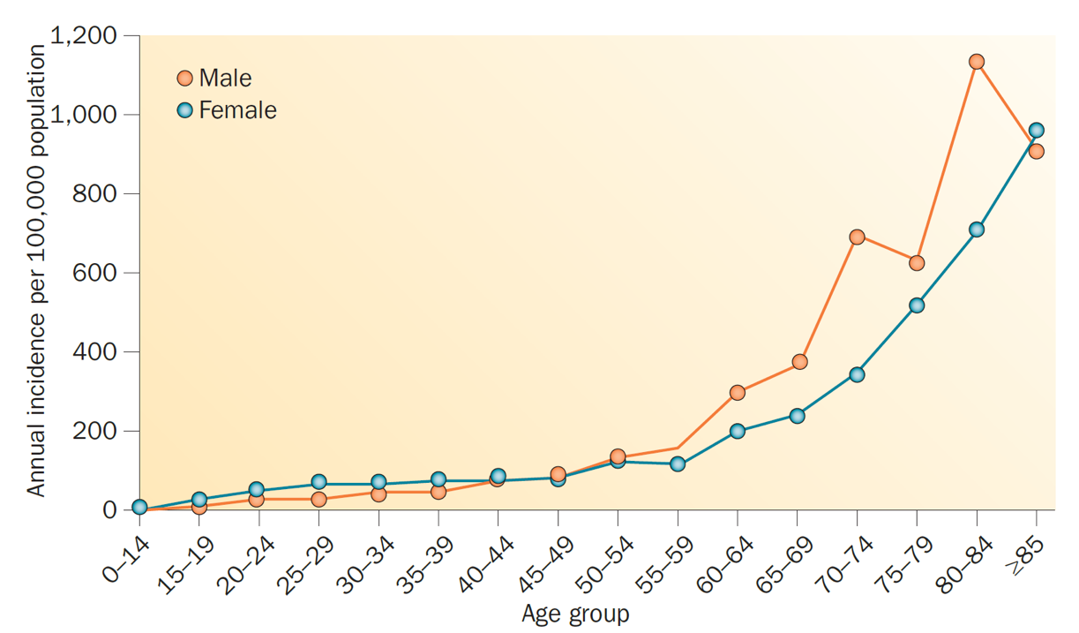
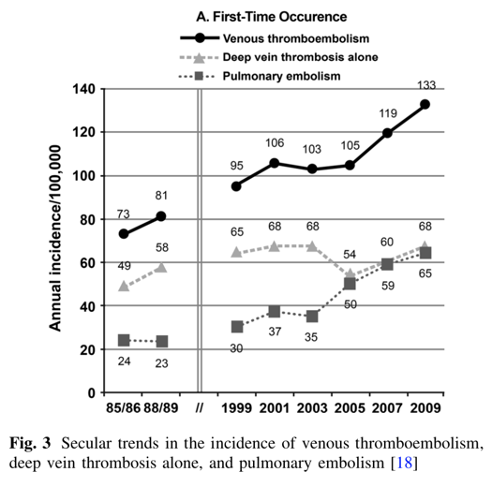
Trends in VTE Diagnosis

Slide 6
Why We Care About VTE
VTE
5 to 10% of symptomatic PE present with shock
True mortality undiagnosed PE likely less than 5%
50% recur within 3 months w/o treatment
Long-term complications PTS, CTEPH, anxiety
Mortality after PE related to comorbidities
Up to 30% mortality at 90 days without treatment

Slide 7
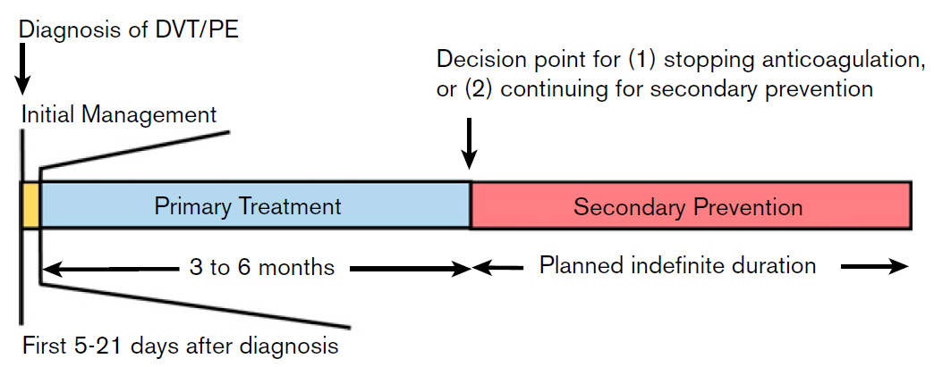
Timeframe for Decisions After VTE Diagnosis

Slide 8

Key Recommendations for Initial Treatment
Uncomplicated DVT
SUGGEST offering home treatment over hospital treatment
conditional recommendation based on low certainty evidence
PE with low risk of complications
SUGGEST offering home treatment over hospital treatment
conditional recommendation based on very low certainty evidence
DVT or PE
SUGGEST DOACs over VKAs
conditional recommendation based on moderate certainty evidence
PE with hemodynamic instability
RECOMMEND thrombolytic therapy followed by anticoagulation over anticoagulation alone
strong recommendation despite low certainty evidence
Intermediate-risk (submassive) PE
SUGGEST anticoagulation alone over the routine use of thrombolysis in addition to anticoagulation
conditional recommendation based on low certainty evidence

Slide 9




Thrombolysis Recommendations for
High-Risk PE
ASH Guidelines
CHEST Guidelines
In patients with acute PE associated with hypotension (eg; systolic BP < 90 mm Hg) who do not have a high bleeding risk, we suggest systemically administered thrombolytic therapy
over no such therapy
(weak recommendation, low-certainty evidence)
For patients with PE and hemodynamic compromise, the ASH guideline panel recommends using thrombolytic therapy followed by anticoagulation over anticoagulation alone
(strong recommendation despite low certainty in the evidence of effects)

Slide 10
Type of Thrombolysis for High-Risk PE
ASH Guidelines
CHEST Guidelines
Acute PE and hypotension with (i) high bleeding risk, (ii) failed systemic thrombolysis, or (iii) shock likely to cause death before effect of systemic thrombolysis suggest catheter assisted thrombus removal
(weak recommendation, low-certainty evidence)
For patients with PE in whom thrombolysis is considered appropriate, the ASH guideline panel suggests using systemic thrombolysis over
catheter-directed thrombolysis
(conditional recommendation based on very low certainty in the evidence of effects)

Slide 11


Recommendations for Intermediate-Risk PE
ASH Guidelines
CHEST Guidelines
The panel suggests anticoagulation alone over the routine use of thrombolysis in addition
to anticoagulation
(conditional recommendation, low certainty)
In most patients with acute PE not associated with hypotension, we recommend against systemically administered
thrombolytic therapy
(strong recommendation, low-certainty evidence)
CHEST Guidelines
Thrombolysis reasonable if low risk for bleeding in selected younger patients or patients at high risk for decompensation due to concomitant cardiopulmonary disease (monitor closely)

Slide 12
DOAC Dosing for VTE May be Different
Than Afib
 | Dabigatran | Rivaroxaban | Apixaban | Edoxaban
Acute VTE standard dose | 150 mg twice daily (after 5-10 day course of LMWH) | 15 mg twice daily for 21 days then 20 mg daily | 10 mg twice daily for 7 days then 5 mg twice daily | 60 mg daily (after 5-10 day course of LMWH)
Acute VTE reduced dose | 110 mg twice daily | No dose reduction | No dose reduction | 30 mg daily
Dose reduction criteria | Age ≥80 yrs, or age ≥75 yrs and 1 risk factor for bleeding |  |  | Weight ≤60 kg, CrCl 30-50 mL/min, use of strong P-Gp inhibitor
Secondary prevention of VTE | 150 mg twice daily | 20 mg or 10 mg daily | 5 mg or 2.5 mg twice daily | 60 mg daily

Slide 13
Anticoagulation Framework
Completion of primary treatment for DVT and/or PE (3 to 6 months of anticoagulation)
Assessment of provoking factors
Unprovoked
Persistent
Transient

Slide 14
Anticoagulation Framework
Completion of primary treatment for DVT and/or PE (3 to 6 months of anticoagulation)
Assessment of provoking factors
Determines risk of recurrence off anticoagulation and informs ongoing treatment
Unprovoked
Persistent
Transient

Slide 15
Anticoagulation Framework
Completion of primary treatment for DVT and/or PE (3 to 6 months of anticoagulation)
Assessment of provoking factors
Determines risk of recurrence off anticoagulation and informs ongoing treatment
Unprovoked
Persistent
Transient
Up to 50% of events

Slide 16
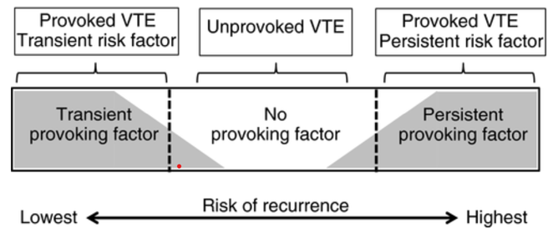
Anticoagulation Framework
Completion of primary treatment for DVT and/or PE (3 to 6 months of anticoagulation)
Assessment of provoking factors
Determines risk of recurrence off anticoagulation and informs ongoing treatment
Unprovoked
Persistent
Transient
Up to 50% of events

Slide 17
Risk Factors Confer Variable Risk

Slide 18



Looking for more resources
on this topic?
CME/CE in minutes
Congress highlights
Late-breaking data
Quizzes
Webinars
In-person events
Slides & resources
www.MedEdOTG.com

